Slide 1
Project Title
SERVERLESS CONTACT FORM USING AWS SERVICES
Name : ABARNA B
Course & BATCH : AWS & DevOps ( July,2025 – 11:30AM to 01:00PM )

Slide 2
Why Contact Form is needed?
Contact forms are essential for websites to collect user feedback or queries
Why Serverless?
Normally, websites use contact form which require traditional servers. This increase cost and maintenance. So I designed a serverless solution.

Slide 3
PROJECT OBJECTIVE
The main objective of my project is to build a simple contact form for a website, where user can submit their details like name, address, contact, email, etc.,
Once the form is submitted, the details are sent to the website owner’s email automatically using AWS service.
In this project, no need to maintain servers. Instead, I make use of AWS services which are cost-effective, scalable, and easy to maintain.

Slide 4
AWS Services Used
Amazon S3 : Hosting static website (HTML form)
Amazon API Gateway : Exposes an HTTPS endpoint for the form to send data.
AWS Lambda : Backend logic to handle form data
Amazon SES : Sends email notification
Amazon CloudWatch : Monitoring & Logs
IAM : Provides secure roles and permissions for Lambda.

Slide 5
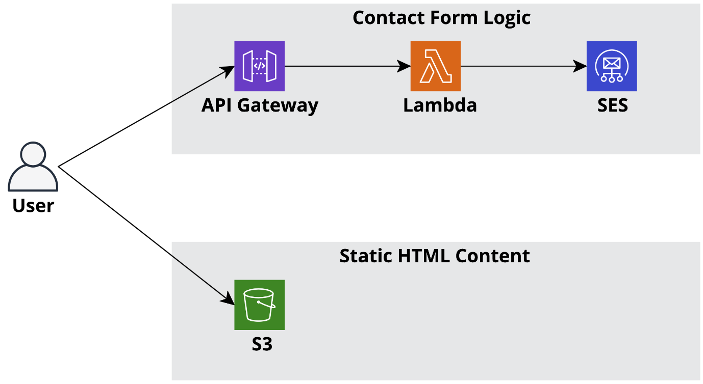
Architecture Diagram

Slide 6
Architecture Diagram Flow
S3 : User submits form (HTML on S3 static website)
API Gateway : API Gateway receives form submission
Lambda: Lambda processes form data and calls SES
SES : Sends email to admin/ website owner.
CloudWatch : CloudWatch for logging and monitoring.

Slide 7
IMPLEMENTATION STEPS BELOW

Slide 8
Step 1 : Amazon SES Setup
AWS Console → SES → Create Identities → Enter Email Id → Click on Create identities
Verified identities → Verify email address. ( Verify both FROM and TO address)
Click the link in Gmail verification mail.

Slide 9
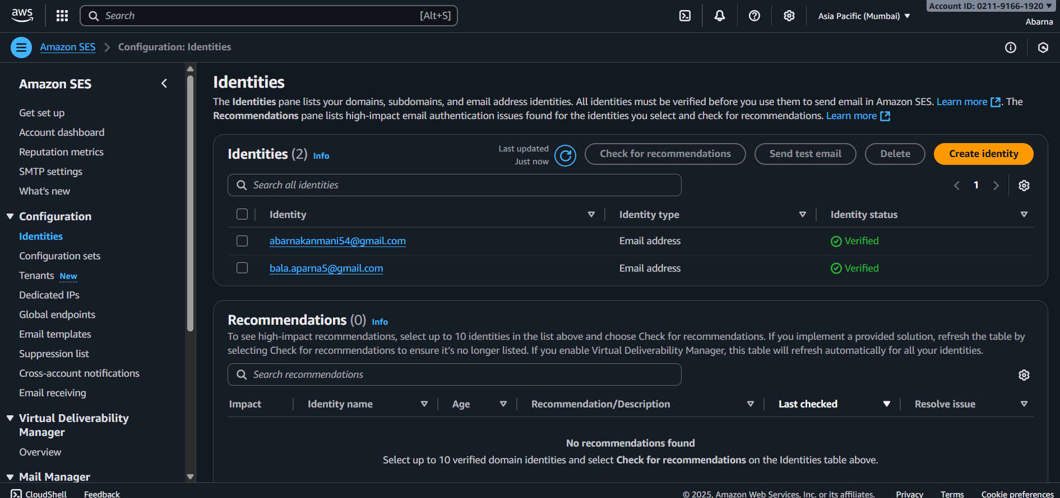

Slide 10
Step 2 : Create IAM Role for Lambda
AWS Console → IAM → Roles → Create role → Choose Trusted entity = AWS Service. Service = Lambda
Attach Permissions: AmazonS3FullAccess , AmazonSESFullAccess, AWSLambda_FullAccess, CloudWatchLogsFullAccess
Enter Role name (eg; Lambda_SES_Role ). Click on “ Create Role “.
Inline policy for SES permissions: (Permissions → Create inline policy)
Inline policy for SES Permissions:
{
"Version": "2012-10-17",
"Statement": [
{ "Effect": "Allow", "Action": ["ses:SendEmail","ses:SendRawEmail"], "Resource": "*" }
]
}

Slide 11
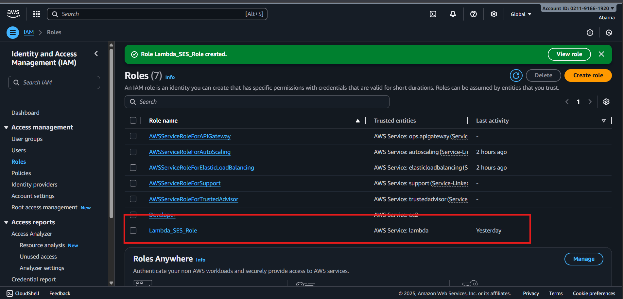
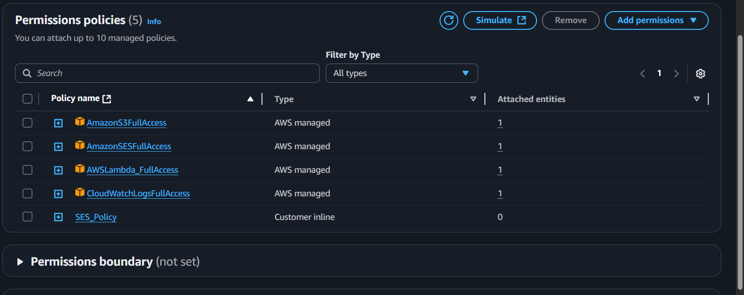

Slide 12
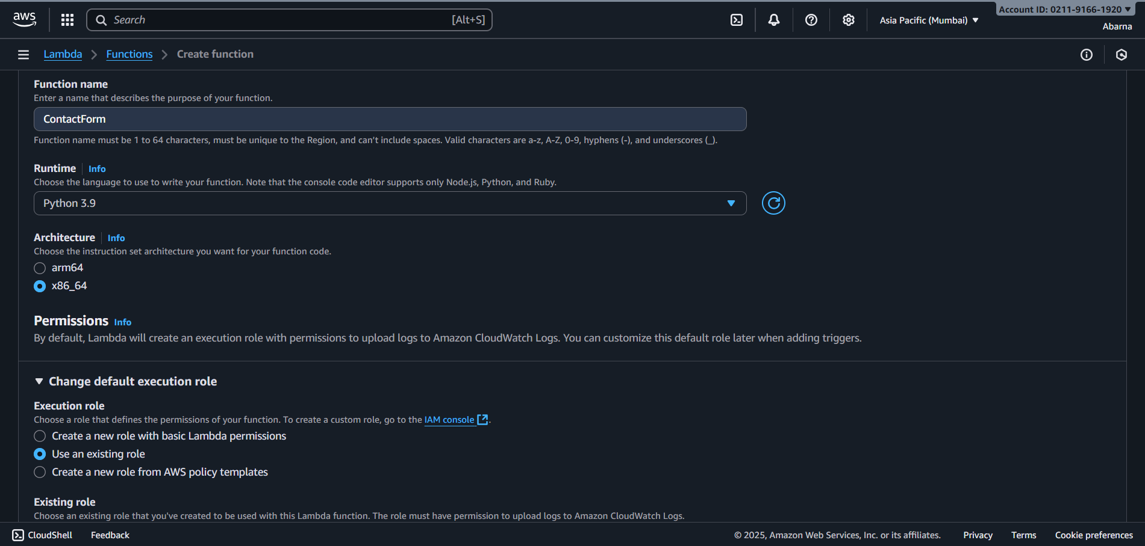
Step 3: Create Lambda Function
AWS Console → Lambda-→ Create Function (Function Name : ContactForm )
Enter name and select Runtime ( Python 3.9 )
In Change default execution role → Use an Existing role → Select created IAM role ( Lambda_SES_Role )and create a function.

Slide 13
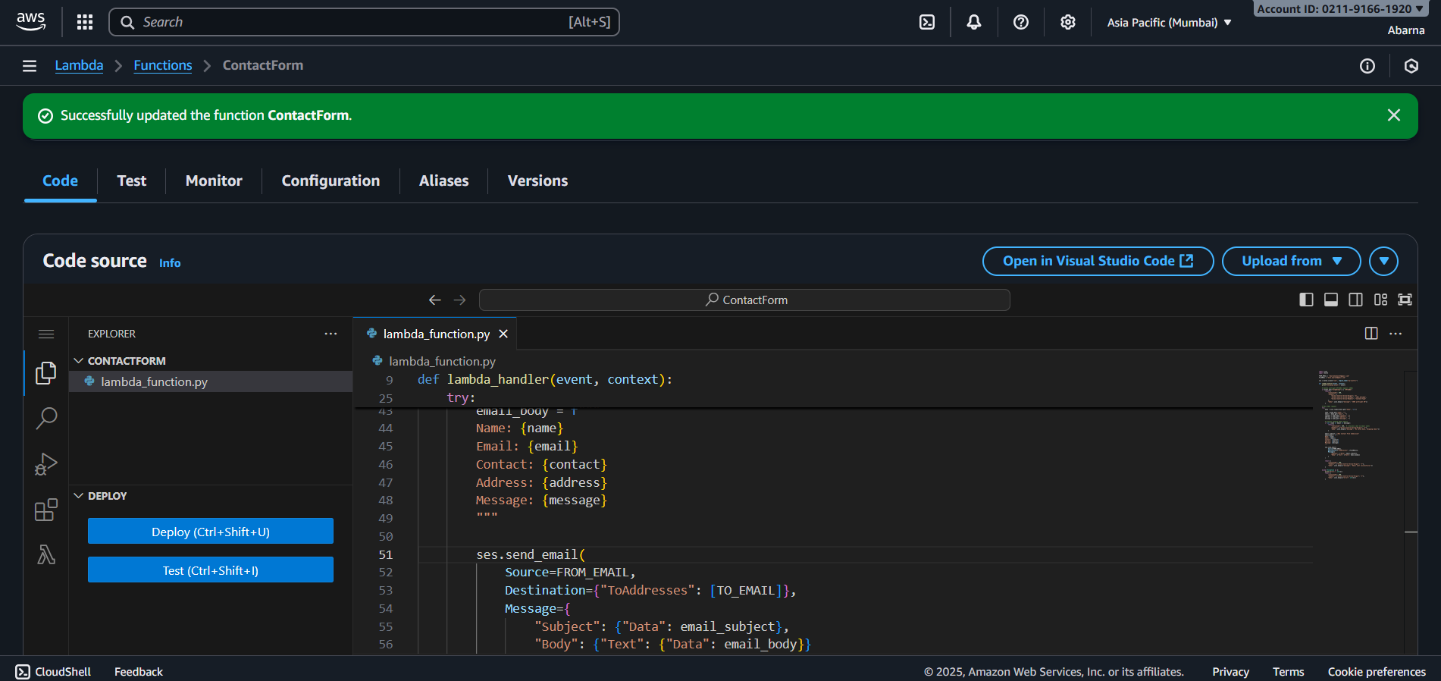
Go to code , enter python 3.9 code and deploy it. Also Test the code for mail verification.

Slide 14
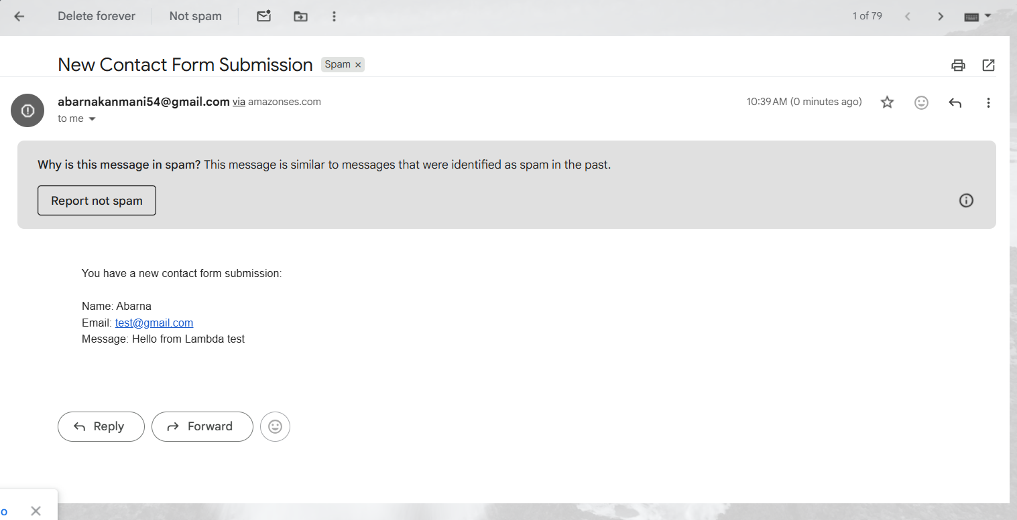
After you tested your code, mail generated in gmail

Slide 15
Lambda Code :
import boto3
import json
import os
# Verified emails in SES
FROM_EMAIL = "abarnakanmani54@gmail.com" # must be verified in SES
TO_EMAIL = "bala.aparna5@gmail.com" # must be verified in SES
ses = boto3.client("ses", region_name="ap-south-1")
def lambda_handler(event, context):
try:
print("Incoming event:", event)
body = json.loads(event["body"])
name = body.get("name", "")
email = body.get("email", "")
message = body.get("message", "")
# Email body
text_body = f"""

Slide 16
Name: {name}
Email: {email}
Message: {message}
"""
# Send email using SES
resp = ses.send_email(
Source=FROM_EMAIL,
Destination={"ToAddresses": [TO_EMAIL]},
Message={
"Subject": {"Data": "New Contact Form Submission"},
"Body": {
"Text": {"Data": text_body}
}
}
)
print("SES Response:", resp)
return {
"statusCode": 200,
"headers": {

Slide 17
"Access-Control-Allow-Origin": "*", # for CORS
"Access-Control-Allow-Methods": "OPTIONS,POST",
"Access-Control-Allow-Headers": "Content-Type"
},
"body": json.dumps({"message": "Email sent successfully!"})
}
except Exception as e:
print("Error:", str(e))
return {
"statusCode": 500,
"headers": {
"Access-Control-Allow-Origin": "*"
},
"body": json.dumps({"message": "Error sending email", "error": str(e)})
}
Code for Test :
{
"body": "{\"name\":\"Abarna\",\"email\":\"test@gmail.com\",\"message\":\"Hello from Lambda test\"}"
}

Slide 18
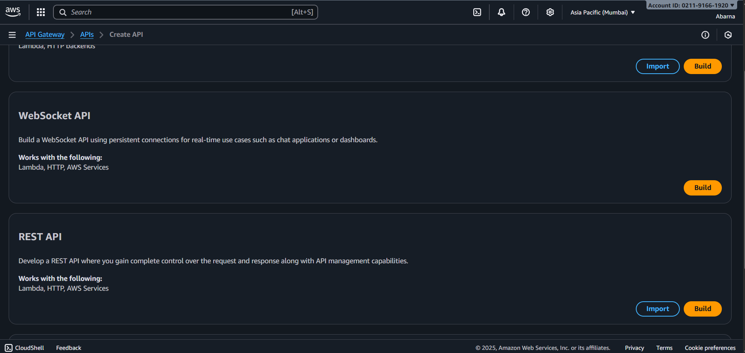
Step 4 : API Gateway (HTTP API) — connect frontend to Lambda
AWS Colsole → API Gateway → Create API → REST API → Build

Slide 19
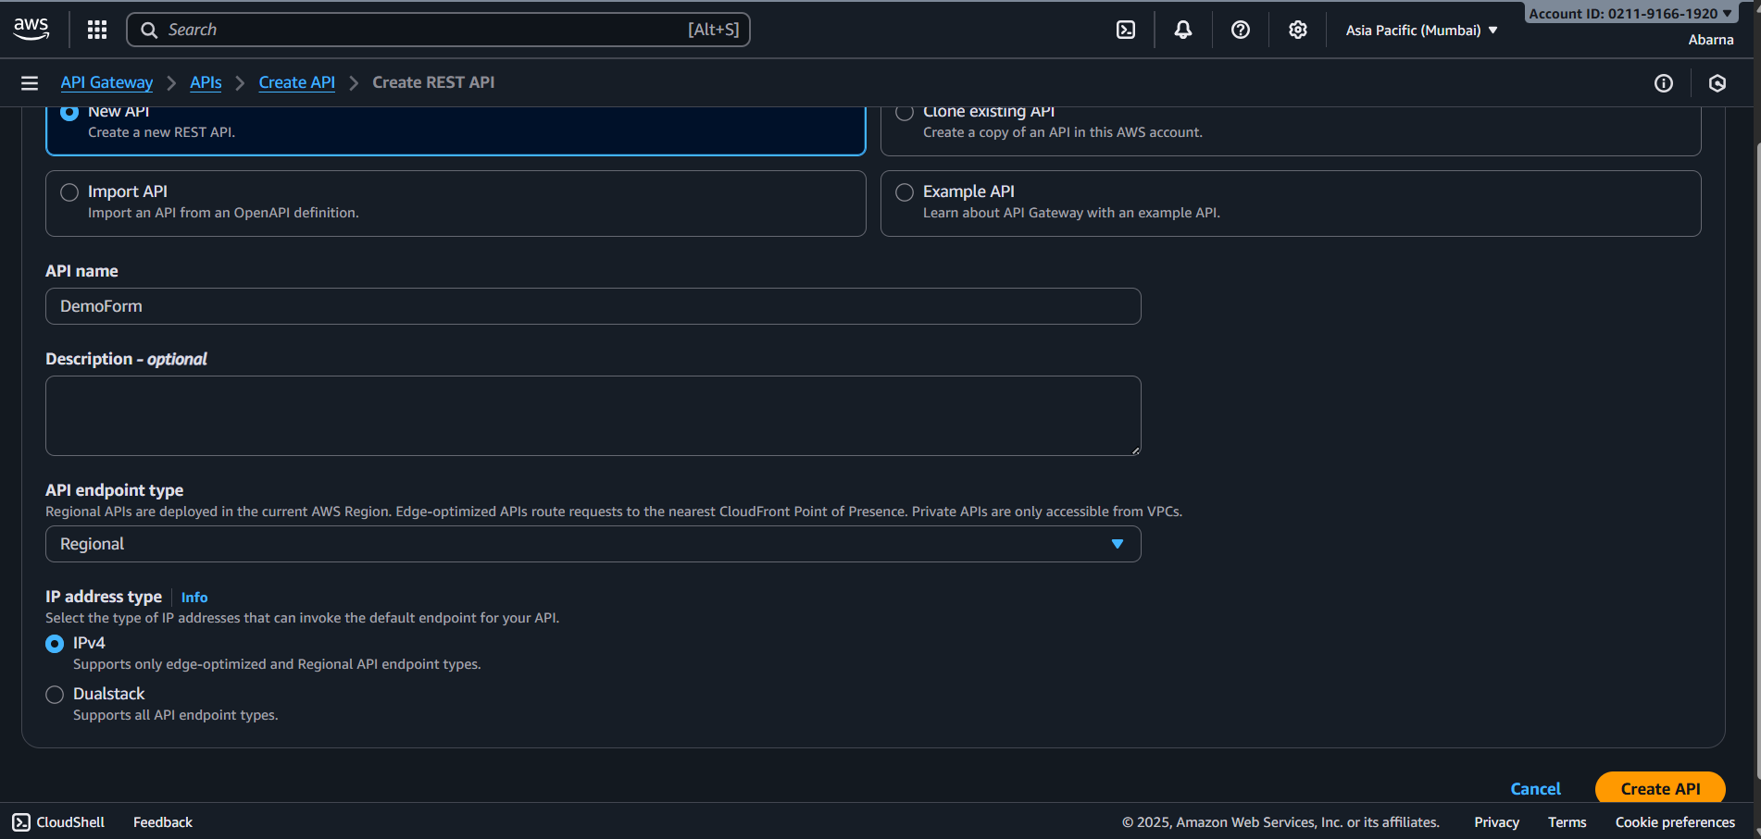
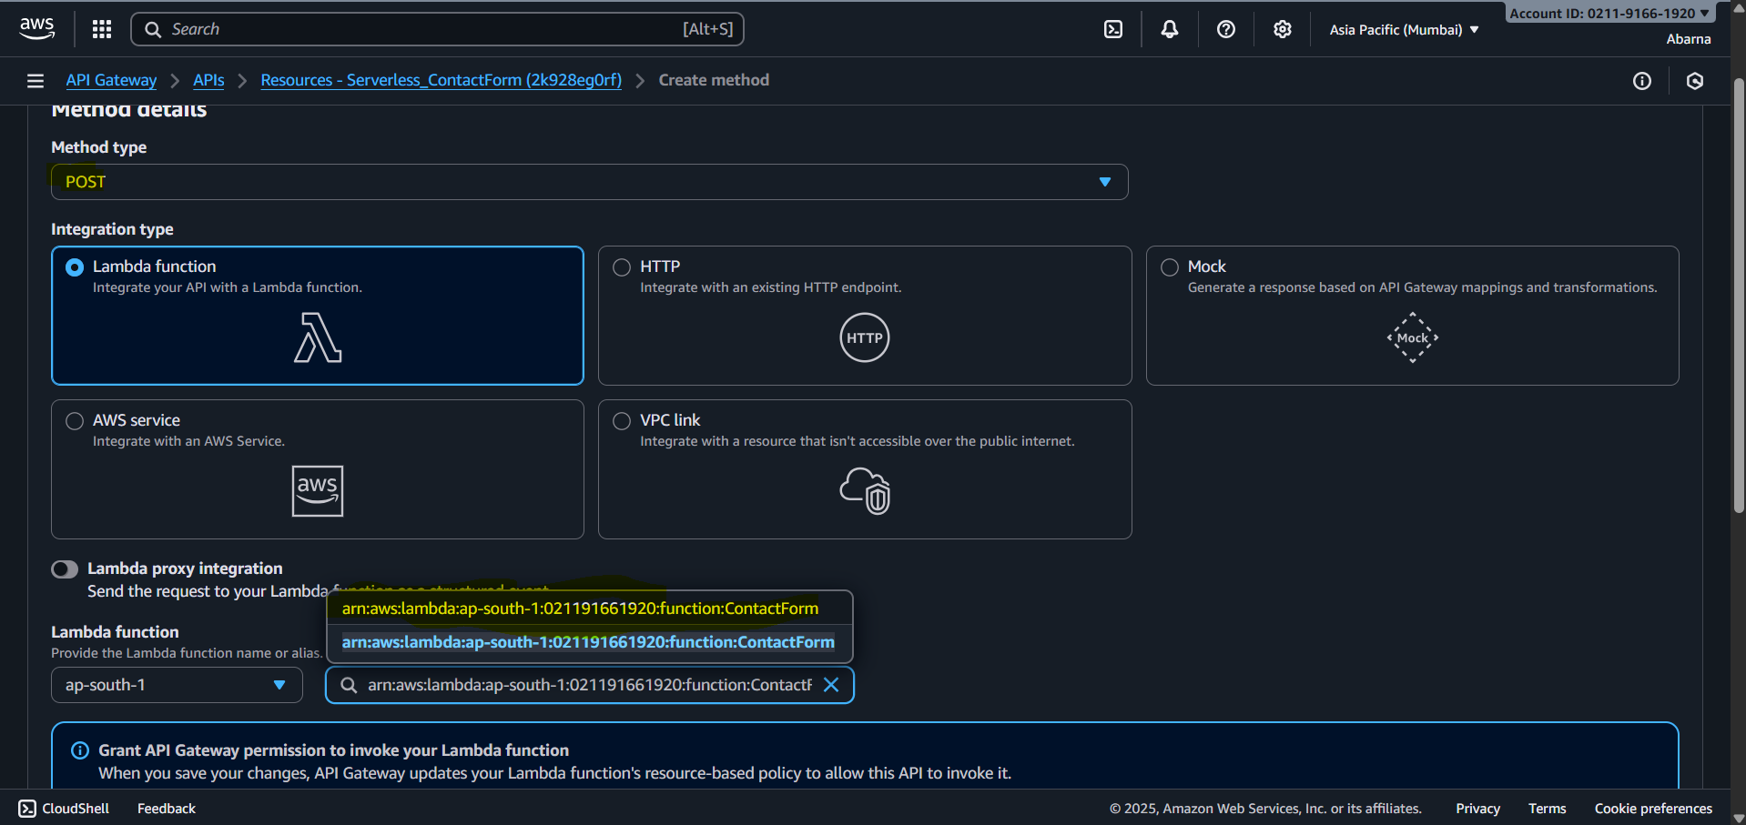
Select New API → Enter name → Click Create API
Create Method → Select POST → Select Created Lambda Function → Create method

Slide 20
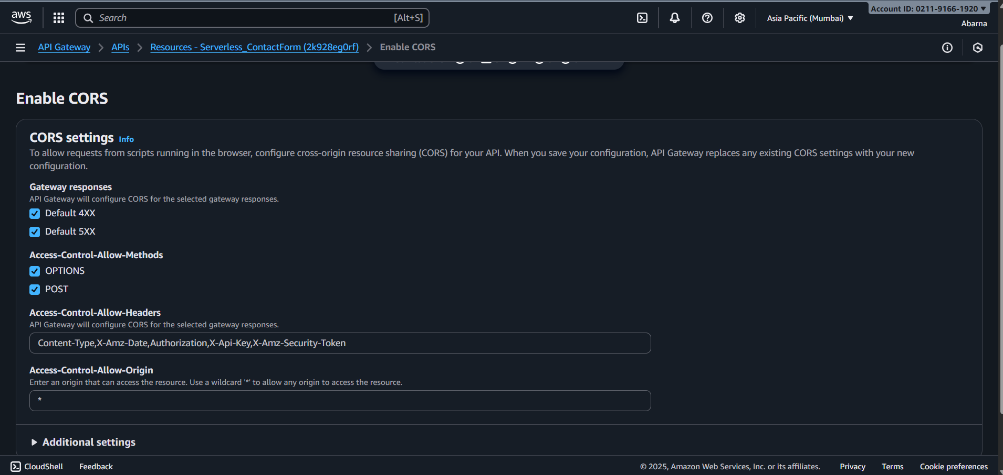
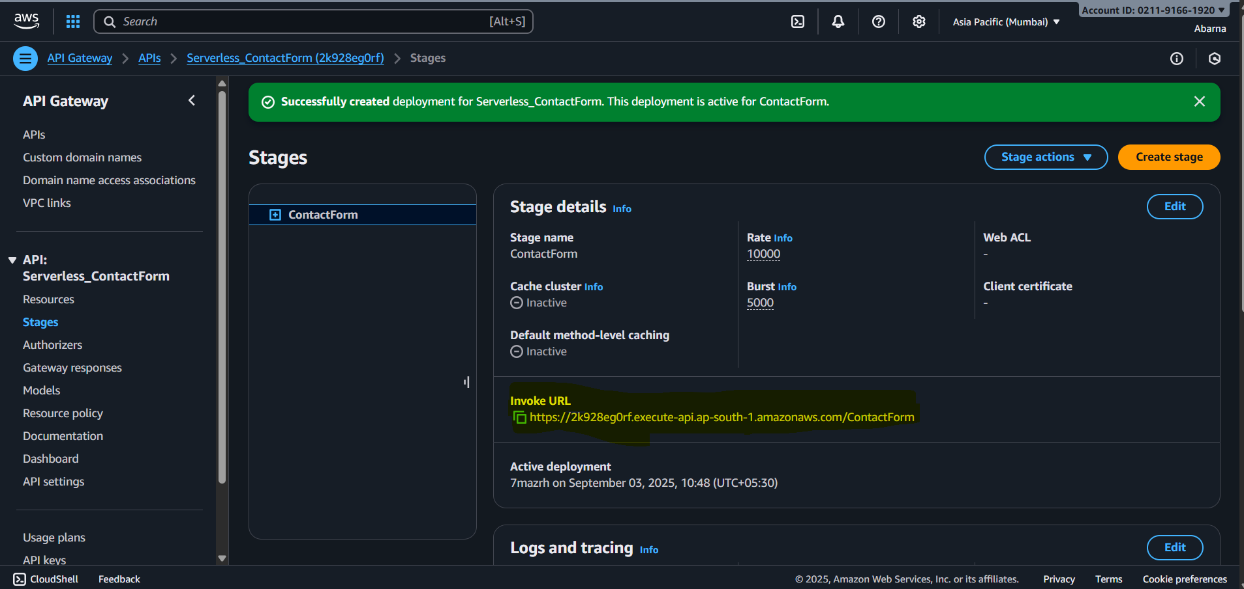
Enable CORS and save it-→ Click on Deploy API
Copy invoke URL (eg https://xxxxxx.execute-api.ap-south-1.amazonaws.com/contact)

Slide 21
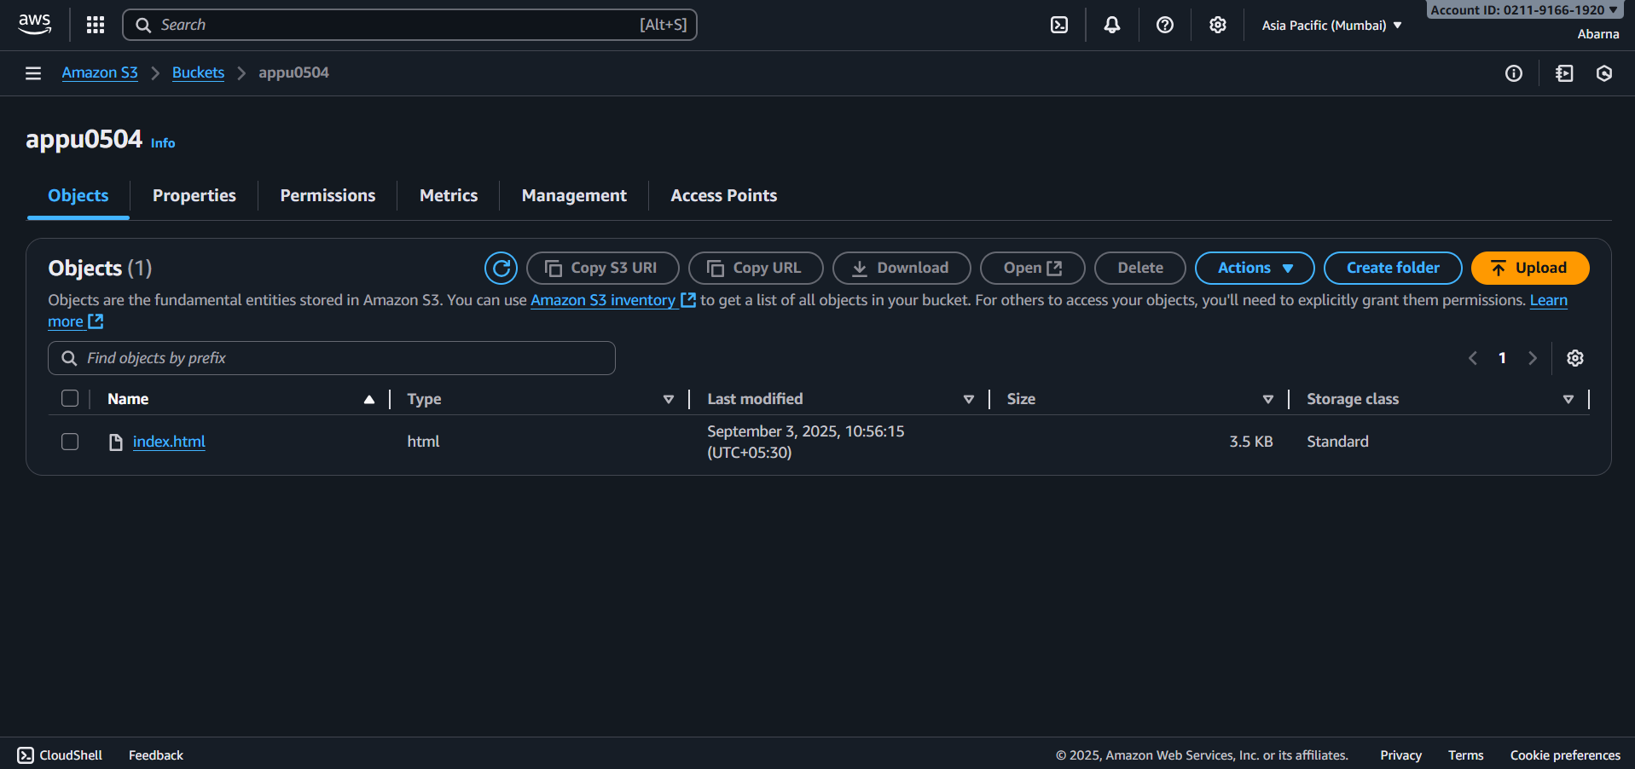
Step5 : S3 static website (frontend)
Amazon Console→ S3 → Create Bucket → upload “ index,html” file ( replace API_ENDPOINT with your invoke URL )
copy the object URL and paste it in browser for output.

Slide 22
Code for S3:
<!DOCTYPE html>
<html lang="en">
<head>
<meta charset="UTF-8" />
<meta name="viewport" content="width=device-width, initial-scale=1.0"/>
<title>Contact Form</title>
<style>
body {
font-family: Arial, sans-serif;
background: linear-gradient(to right, #6a11cb, #2575fc);
display: flex;
justify-content: center;
align-items: center;
height: 100vh;
margin: 0;
}
.container {
background: white;
padding: 30px;
border-radius: 12px;
box-shadow: 0px 4px 12px rgba(0,0,0,0.2);
width: 400px;
}

Slide 23
h2 { text-align: center; margin-bottom: 20px; }
input, textarea {
width: 100%;
padding: 12px;
margin: 8px 0;
border: 1px solid #ccc;
border-radius: 6px;
}
button {
background: #2575fc;
color: white;
padding: 12px;
width: 100%;
border: none;
border-radius: 6px;
cursor: pointer;
}
button:hover { background: #6a11cb; }

Slide 24
</style>
</head>
<body>
<div class="container">
<h2>Contact Us</h2>
<form id="contactForm">
<input type="text" id="name" placeholder="Your Name" required>
<input type="email" id="email" placeholder="Your Email" required>
<textarea id="message" placeholder="Your Message" rows="5" required></textarea>
<button type="submit">Send</button>
</form>
<p id="responseMessage" style="text-align:center; margin-top:10px;"></p>
</div>
<script>
document.getElementById("contactForm").addEventListener("submit", async (e) => {
e.preventDefault();
const name = document.getElementById("name").value;
const email = document.getElementById("email").value;
const message = document.getElementById("message").value;

Slide 25
try {
const response = await fetch("https://<api-id>.execute-api.ap-south-1.amazonaws.com/prod/ContactForm", {
method: "POST",
headers: { "Content-Type": "application/json" },
body: JSON.stringify({ name, email, message })
});
const data = await response.json();
document.getElementById("responseMessage").innerText = data.message;
} catch (error) {
document.getElementById("responseMessage").innerText = "Something went wrong!";
}
});
</script>
</body>
</html>

Slide 26
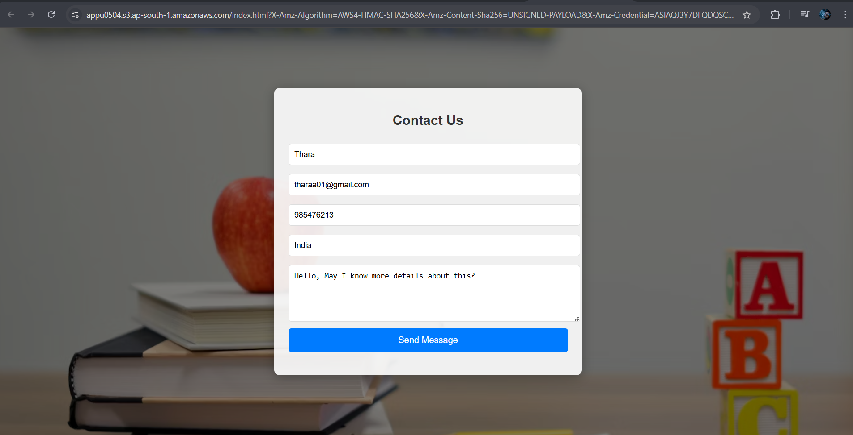
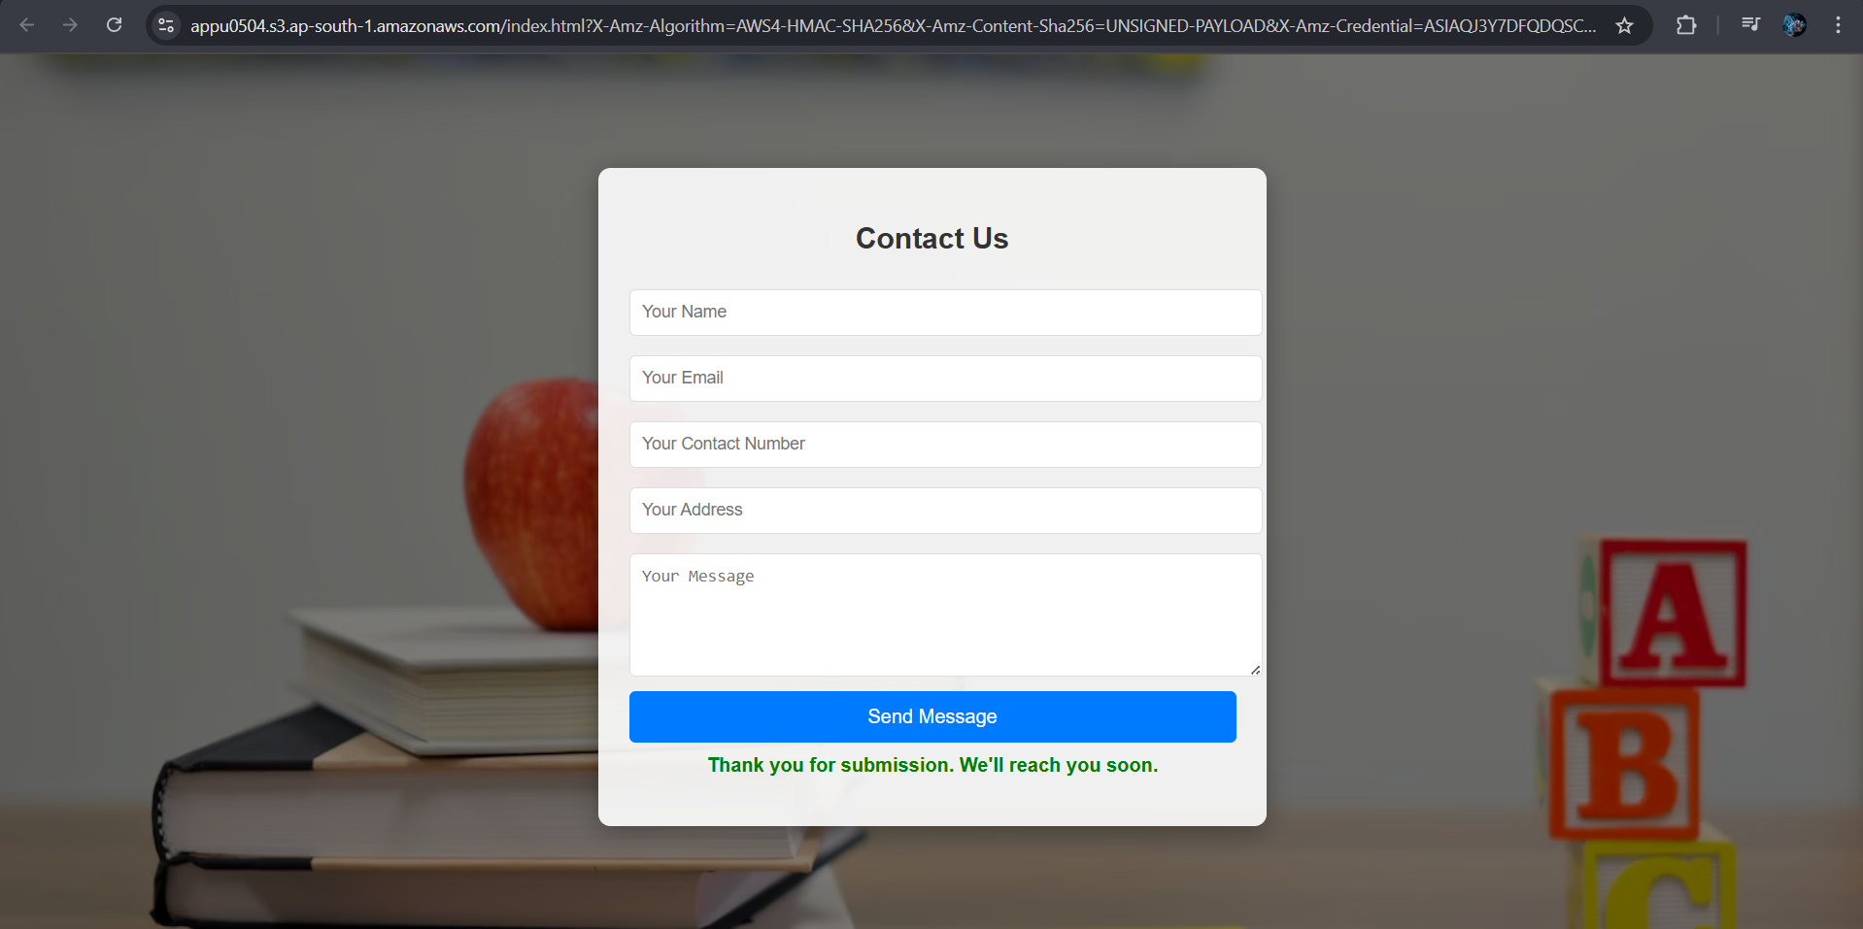
Testing/Output:
Fill in the contact form and click Submit / Send Message
You receive Successful message. ( Thank you for submission. We’ll reach you soon. )

Slide 27
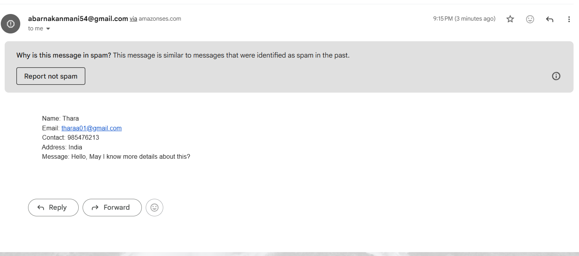
Email Output:
After submitted, you receive Email

Slide 28
Conclusion:
The project demonstrates a serverless web application hosted fully on AWS, eliminating the need for traditional backend servers. It is cost-effective, scalable, and easy to maintain.
It showcases skills in cloud computing, serverless architecture, IAM security, and API development

Slide 29
THANK YOU
Questions?

